Slide 1
Introduction to the Assyrian Genocide

Slide 2
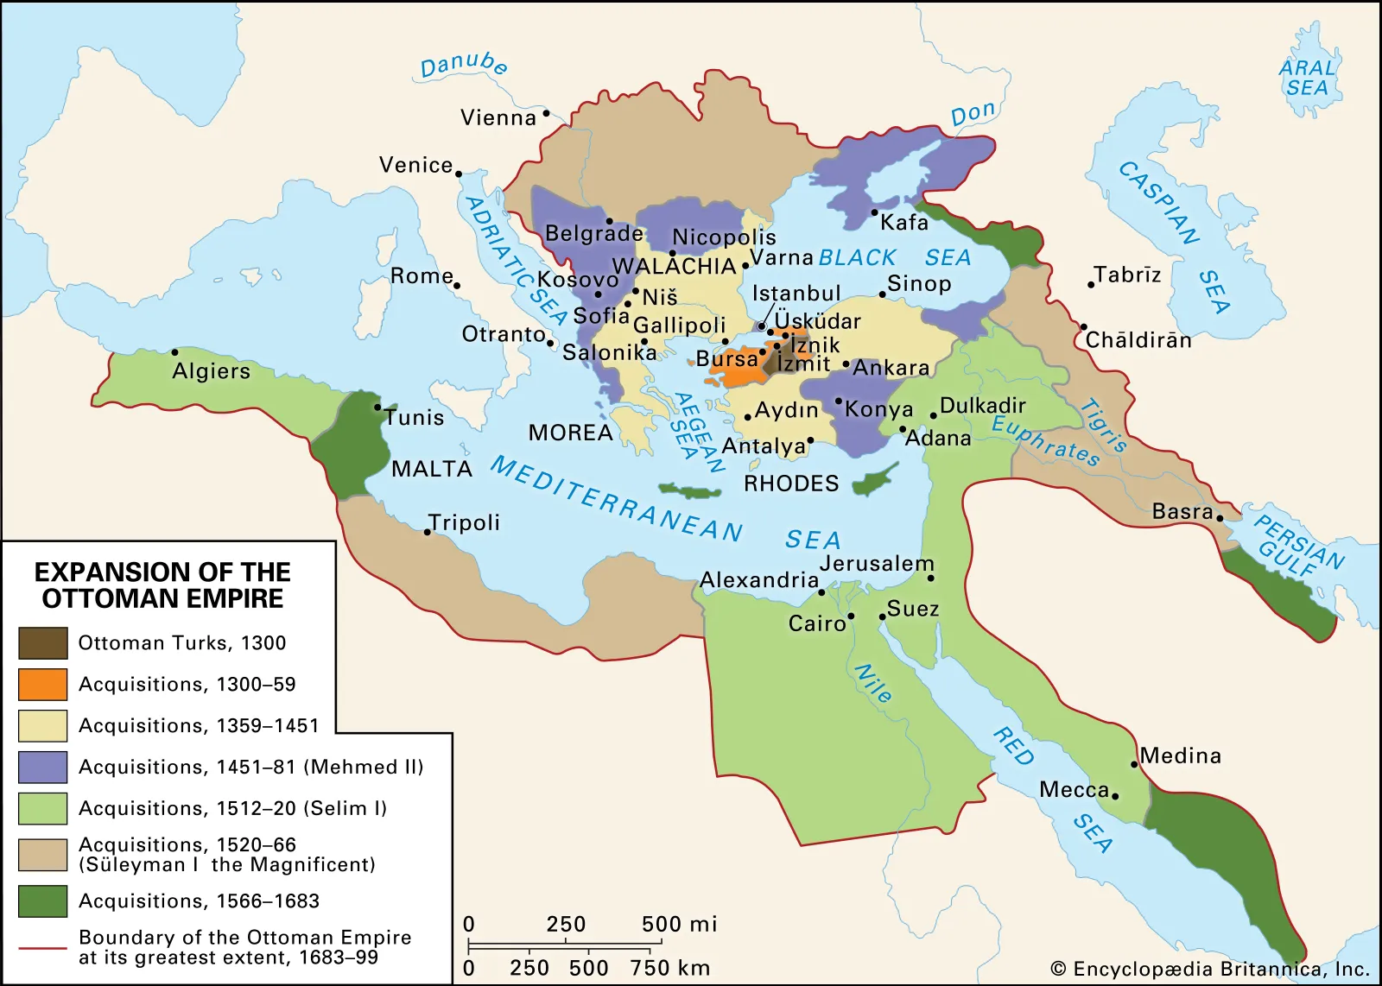
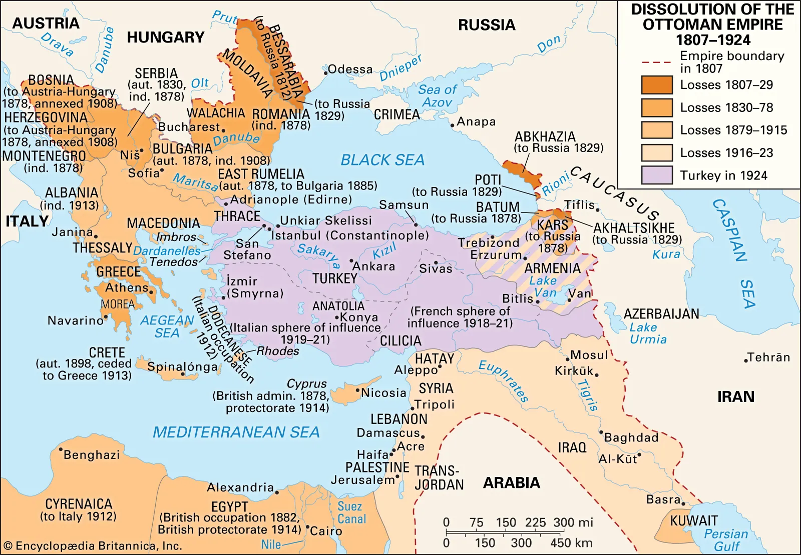
The Ottoman Empire: Expansion (1300-1699) vs. 1914
Notes:
This map shows the reach of the Ottoman Empire at its greatest extent (late 17th century), spanning portions of Asia, Europe, and North Africa. It may help students envision the rich diversity and power of the empire, and how this stands in contrast to what remained by WWI, as territory was lost to European conflict and small nationalist movements - and how such loss of territory, power, and wealth may have impacted political leadership and insecurities within the Empire, making small minority populations increasingly vulnerable.

Slide 3
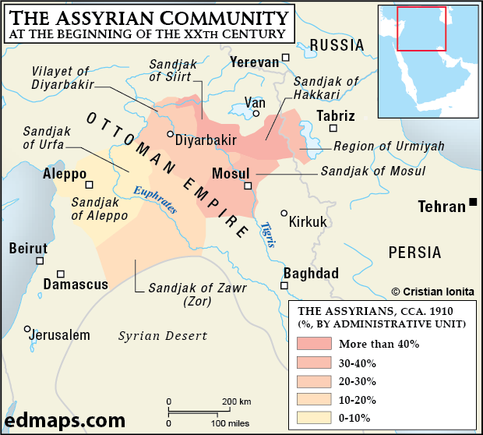
Assyrians in the Ottoman Empire and Persia
Source for above: edumaps.com
Notes:
These maps locate the Assyrian population within the Ottoman and Persian Empires. As the map on the left shows, much of the population was concentrated in present-day Turkey (especially Hakkari, and near Diyarbakir), northern Iraq, and Iran (the Urmia region). Borders back then were not as firm as they are today, and many crossed back and forth between the mountainous Hakkari region and nearby Urmia.

Slide 4
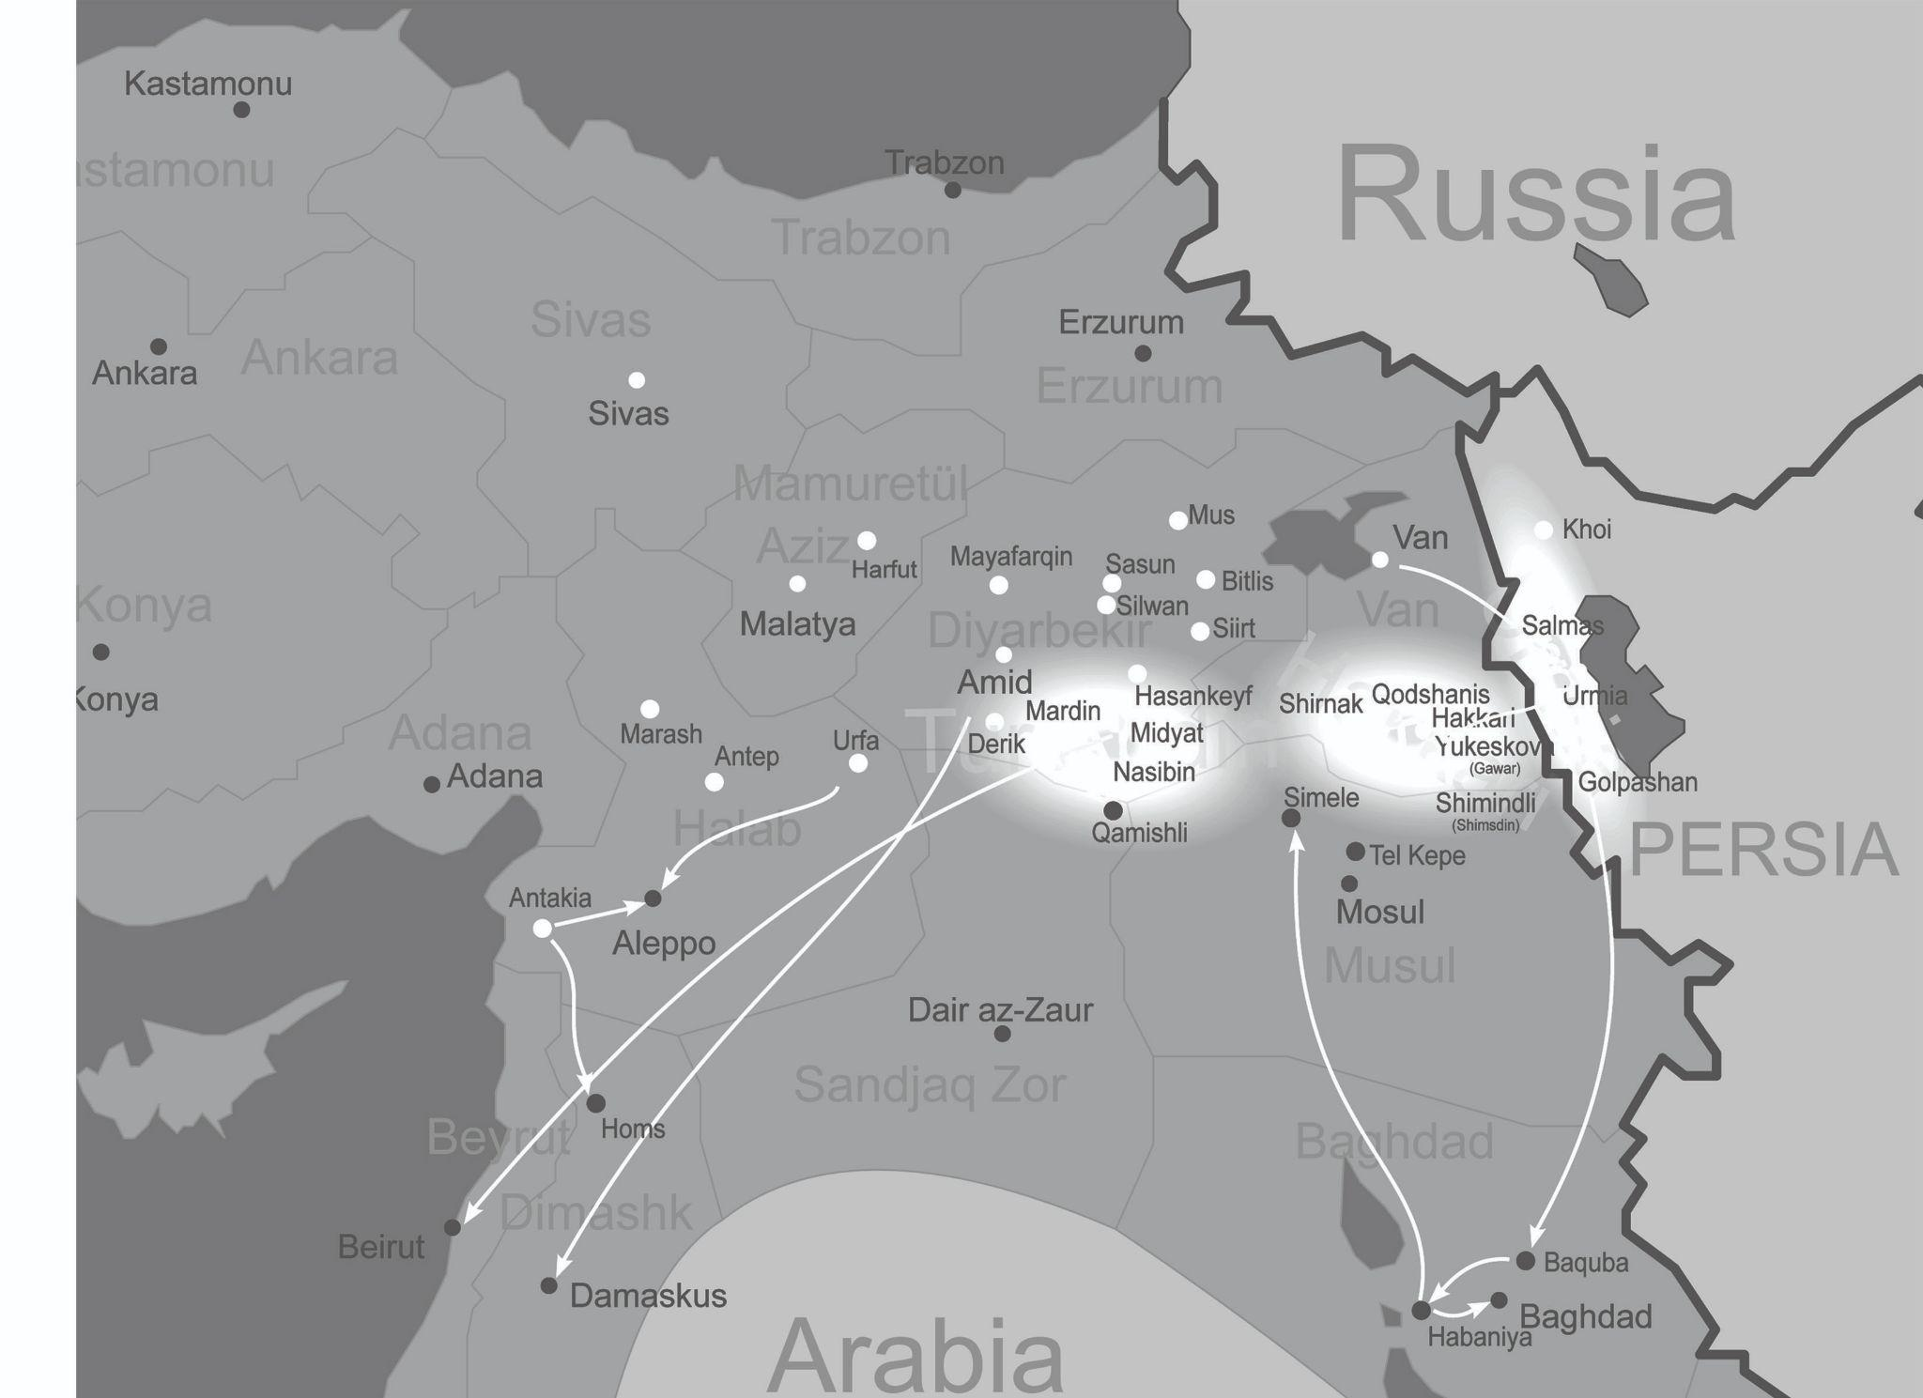
Genocide
Key
Whitened areas: areas with major Assyrian populations
White lines: paths of flight
White dots: towns where violence occurred
Image: Rafy, Assyrian genocide map, 2011, via Wikipedia, modified:
en.wikipedia.org/wiki/File:Assyrian_genocide_map.svg
Notes:
The map highlights key areas of Assyrian populations where violence occurred, and notes primary routes of flight and later resettlement. Notably, attacks did not end when Assyrians fled into Persia, but rather both Ottoman and Persian Assyrians were killed, underscoring the genocidal nature of the violence. The white lines show major flight paths - significantly, from Hakkari to Urmia, and from there to Baquba near Baghdad. Thousands of Assyrians died of attacks, exposure, disease, and hunger as they fled violence in Urmia and sought refuge under British protection in Iraq. By contrast, Assyrians in more western areas like Mardin generally fled to Aleppo, Damascus, and Beirut (present-day Syria and Lebanon). (Note Dair az-Zaur, in the Syrian desert, is labeled on the map. It was one of the destinations to which Armenians who survived the genocide were deported.)

Slide 5
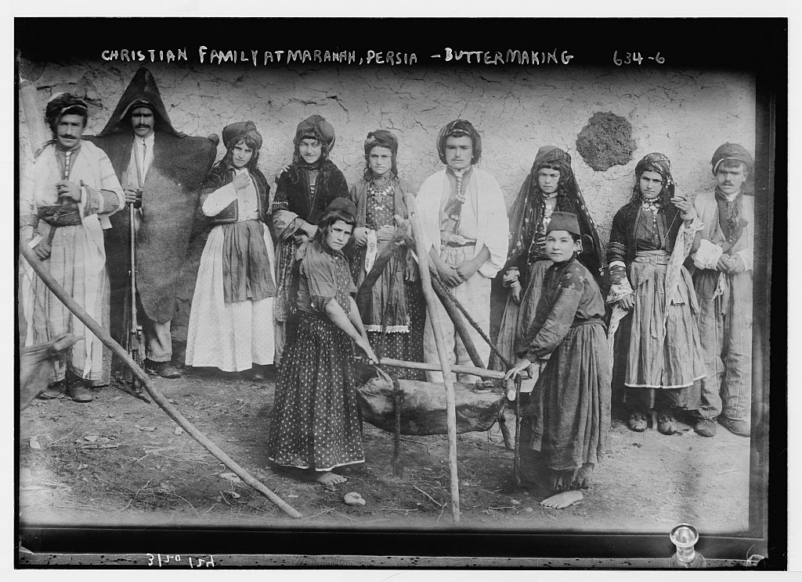
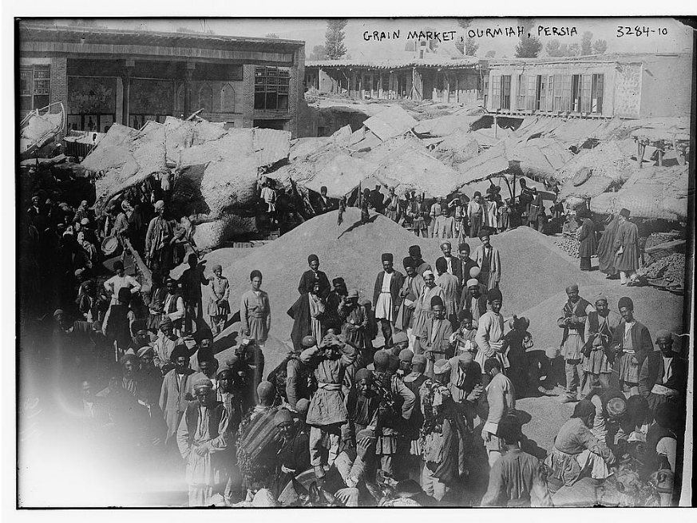
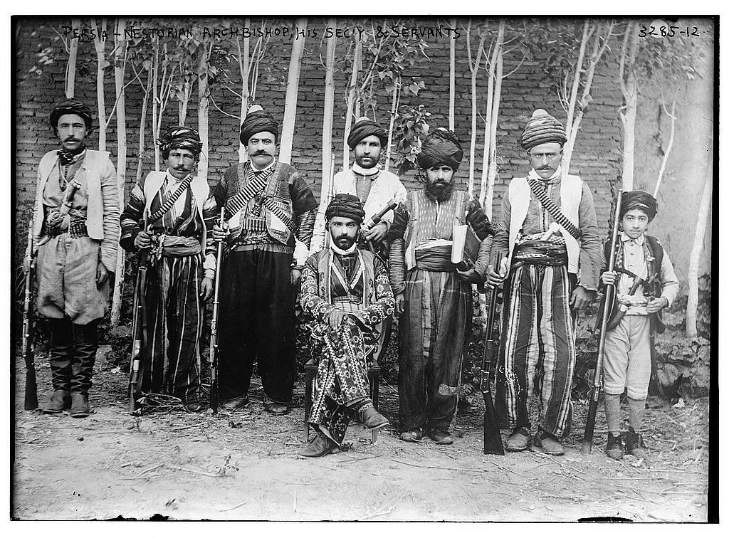
Life before 1914
(above) A family makes butter in Mawana, Persia, date unknown
(above right) A grain market in Urmia, Persia, c. 1911
(right) Shemasha (Deacon) Ishai d'Mar Shimun (father of Patriarch Mar Benyamin Shimun) and attendants, likely in Urmia, Persia, or Hakkari, Ottoman Empire, c. 1890-1895
All images from the Library of Congress
Notes:
These images show brief glimpses into Assyrian life before WWI, including a family making butter; street markets; and members of the Mar Shimun family.

Slide 6
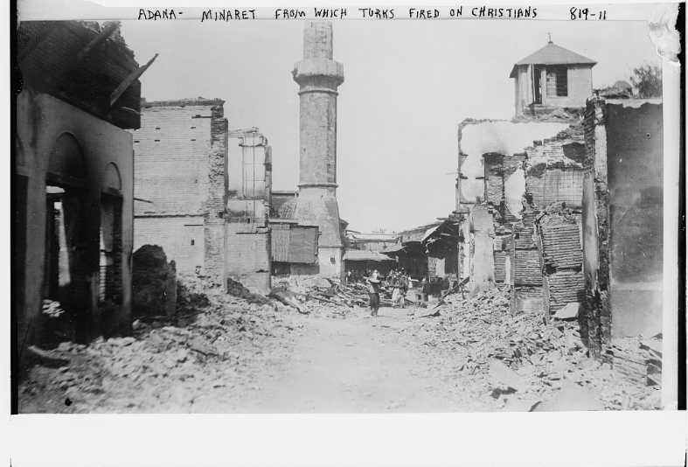
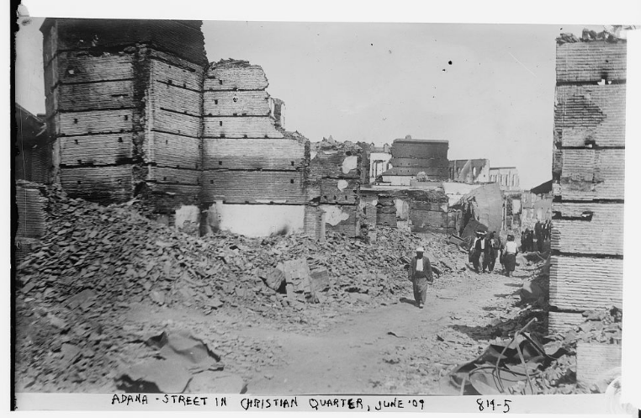
Images from the Adana Massacre (1909)
(L) ‘Adana - Minaret from which Turks fired on Christians’
(R) ‘Adana - Street in Christian Quarter, June ‘09’
Images from the Library of Congress
Notes:
Massacres like the brutal attack in Adana (present-day Turkey) in 1909, in which an estimated 30,000 Armenians and other Christian residents, were indiscriminately killed by opponents of the Young Turk revolution. This massacre underscored the rising tensions and violence within the Empire, and the use of Christian populations as scapegoats for political, economic, and other frustrations.

Slide 7
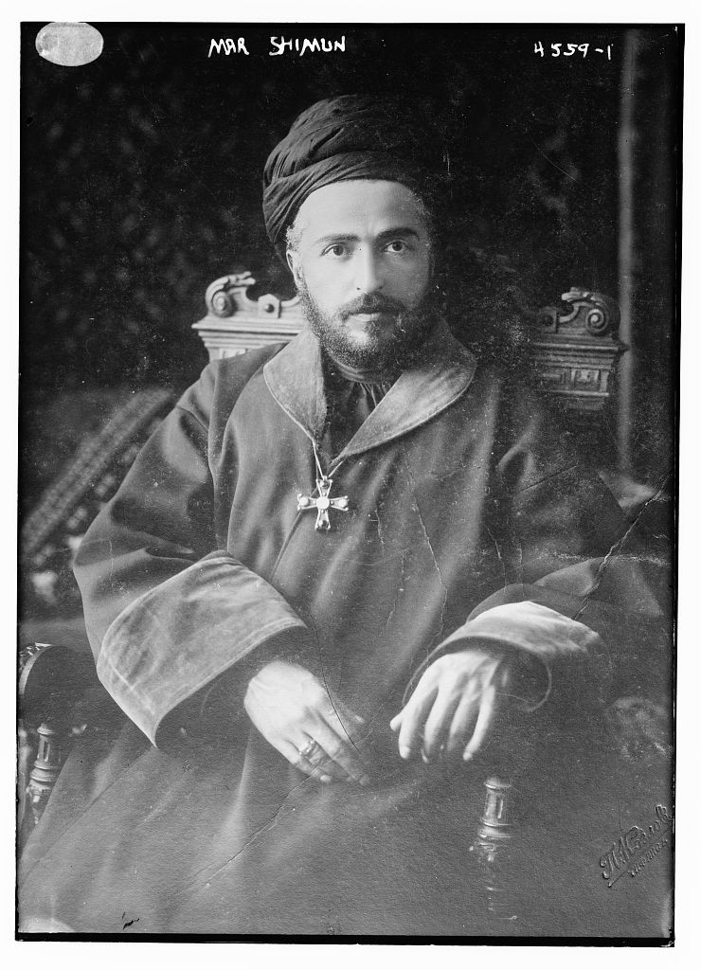
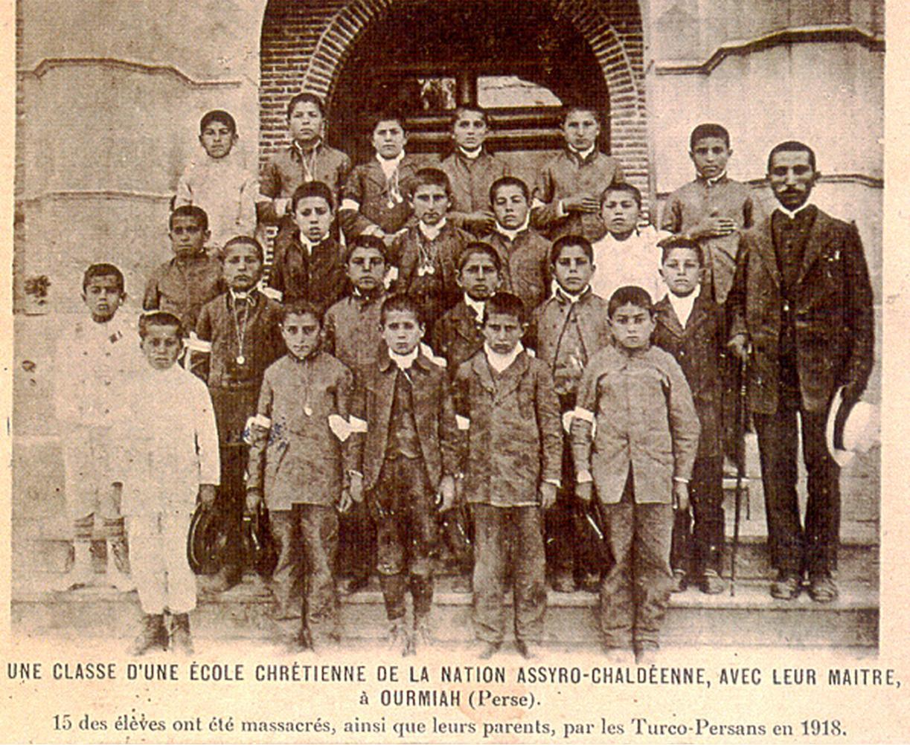
(left) A class at one of the Assyro-Chaldean schools in Urmia, Persia. 15 of the students were killed alongside their parents in 1918.
(right) Mar Benyamin Shimun, Patriarch of the Church of the East, who was killed during a peace negotiation in 1918
Notes:
This images show victims of the genocide: schoolchildren in Urmia (left); and Mar Benymain Shimun (right), the patriarch of the Assyrian Church of the East. One of the reasons the murderous attacks on Assyrians is understood to be a genocide is because of the totality of the violence: any Assyrian, from religious figures to civilians to children, was at risk of being killed.

Slide 8
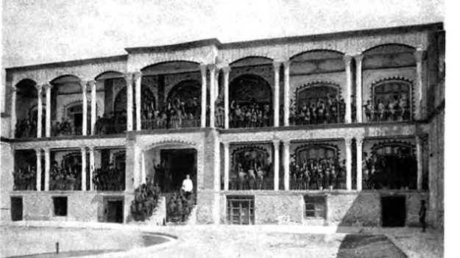
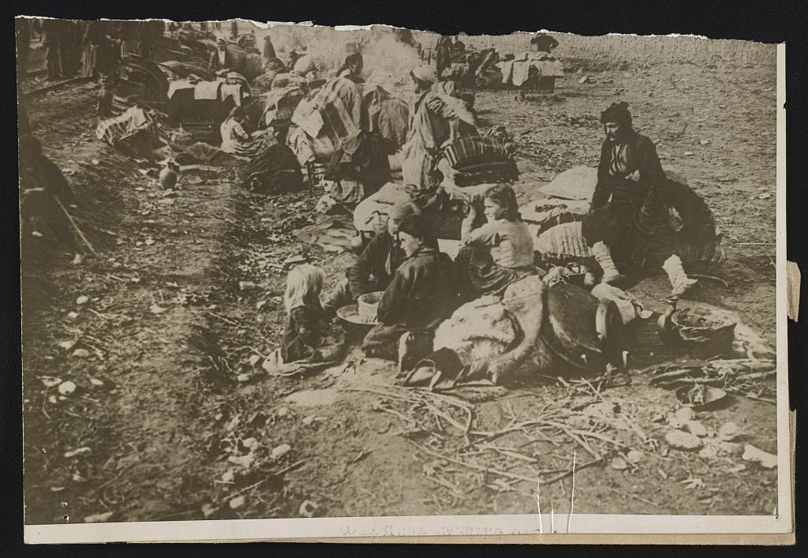
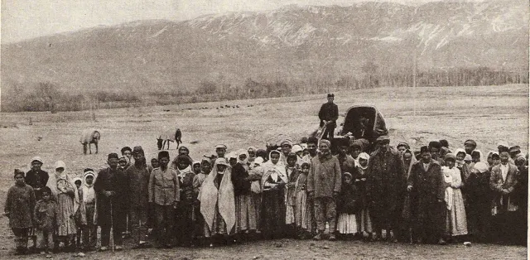
Refugees
(above) Boys orphanage, Tabriz, Persia, c. 1925
(above right) Assyrians from Persia waiting beside a railroad in the Iraq desert, c. 1919
(right) Assyrian refugees in Persia who received food, clothing, and support from the Near East Relief humanitarian organization, c. 1922
(images Near East Relief)
Notes:
Images from the early years following genocide. Charities established orphanages across the region to house and educate the tens of thousands of children whose parents were killed, including the boys orphanage pictured here. Other images show refugees awaiting transportation to a refugee camp, and some of those supported by Near East Relief charity.

Slide 9
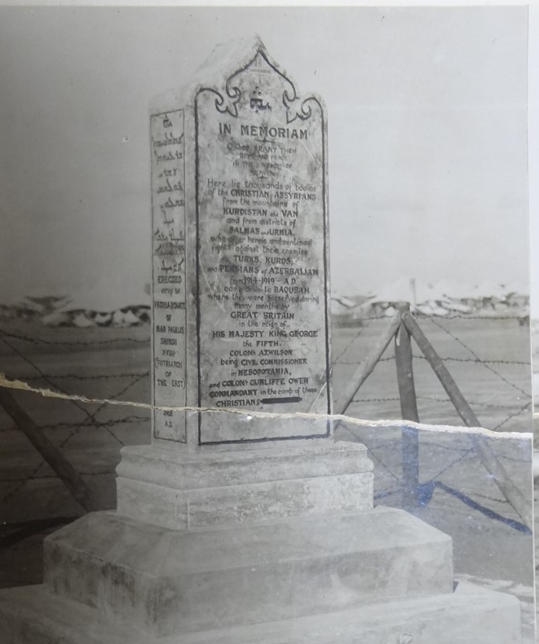
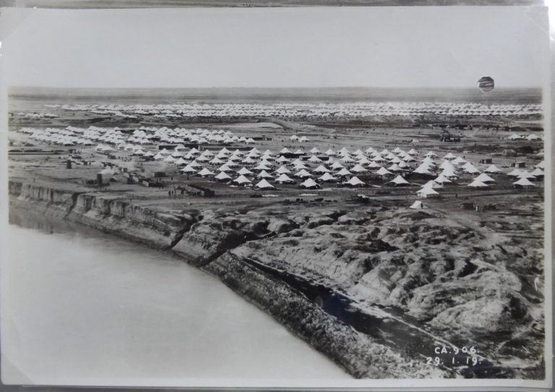
Baqubah Refugee Camp
(above) Tent housing in Baqubah
(right) Memorial constructed in Baqubah to the victims of the Ottoman atrocities
(Images from the British National Archives)
Notes:
Baqubah is the refugee camp established by Britain near the end of WWI to house approximately 40,000 Assyrian and Armenian refugees. The image on the left shows makeshift tents; the image on the right shows a memorial Assyrian genocide survivors constructed to those who were lost.

Slide 10
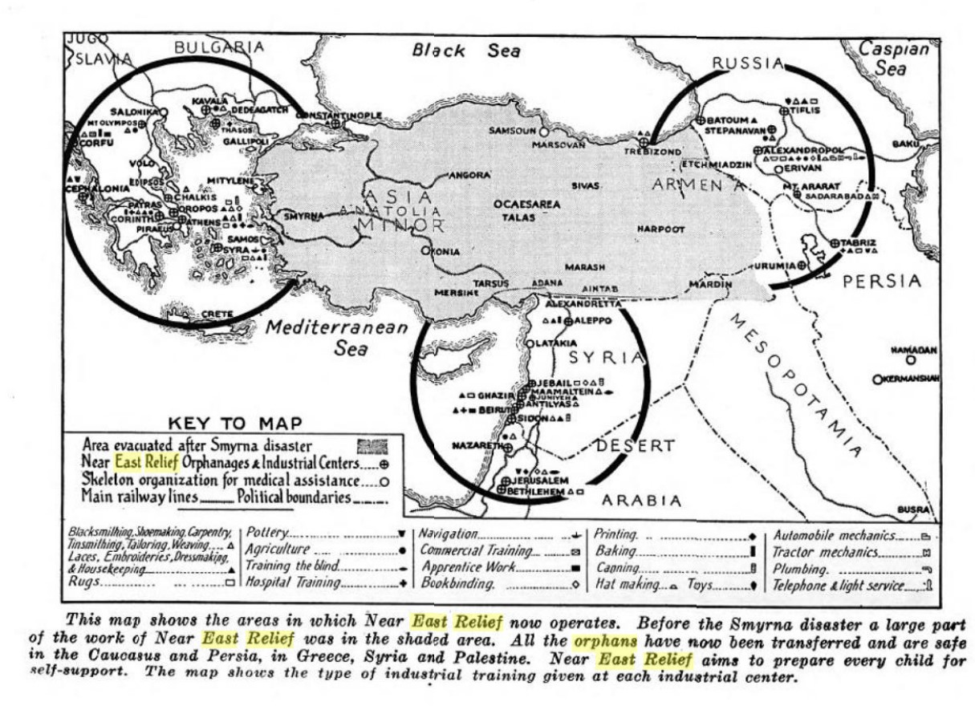
Notes:
Near East Relief provided significant humanitarian aid, administered orphanages and housing, and offered other essential aid to Assyrian, Armenian, Greek, and other refugees following WWI. The map shows the extent of its operations by 1922.

Slide 11
Diaspora today (population estimates)
Iran: 10,000-30,000
Iraq: 150,000-300,000
Syria: 200,000-877,000
Turkey: 18,000-25,000
Australia: 60,000
Canada: 30,000
France: 16,000-50,000
Germany: 70,000-100,000
Jordan: 40,000-100,000
Lebanon: 80,000
Russia: 14,000-70,000
Sweden: 150,000
U.S.: 300,000-400,000
I
Notes:
In addition to the loss of life, community, and home, a lasting impact of the genocide was the inability of people to ever return home. The population figures here, which reflect best estimates, show Assyrian population estimates in the four homeland states (Iran, Iraq, Syria, Turkey) and in countries that have a significant diaspora population. Please note that many of these are estimates as most countries do not have a census designation for Assyrians and several (especially Iraq, Syra, and Jordan) have significantly internally displaced and/or refugee populations because of recent conflicts.

Slide 12
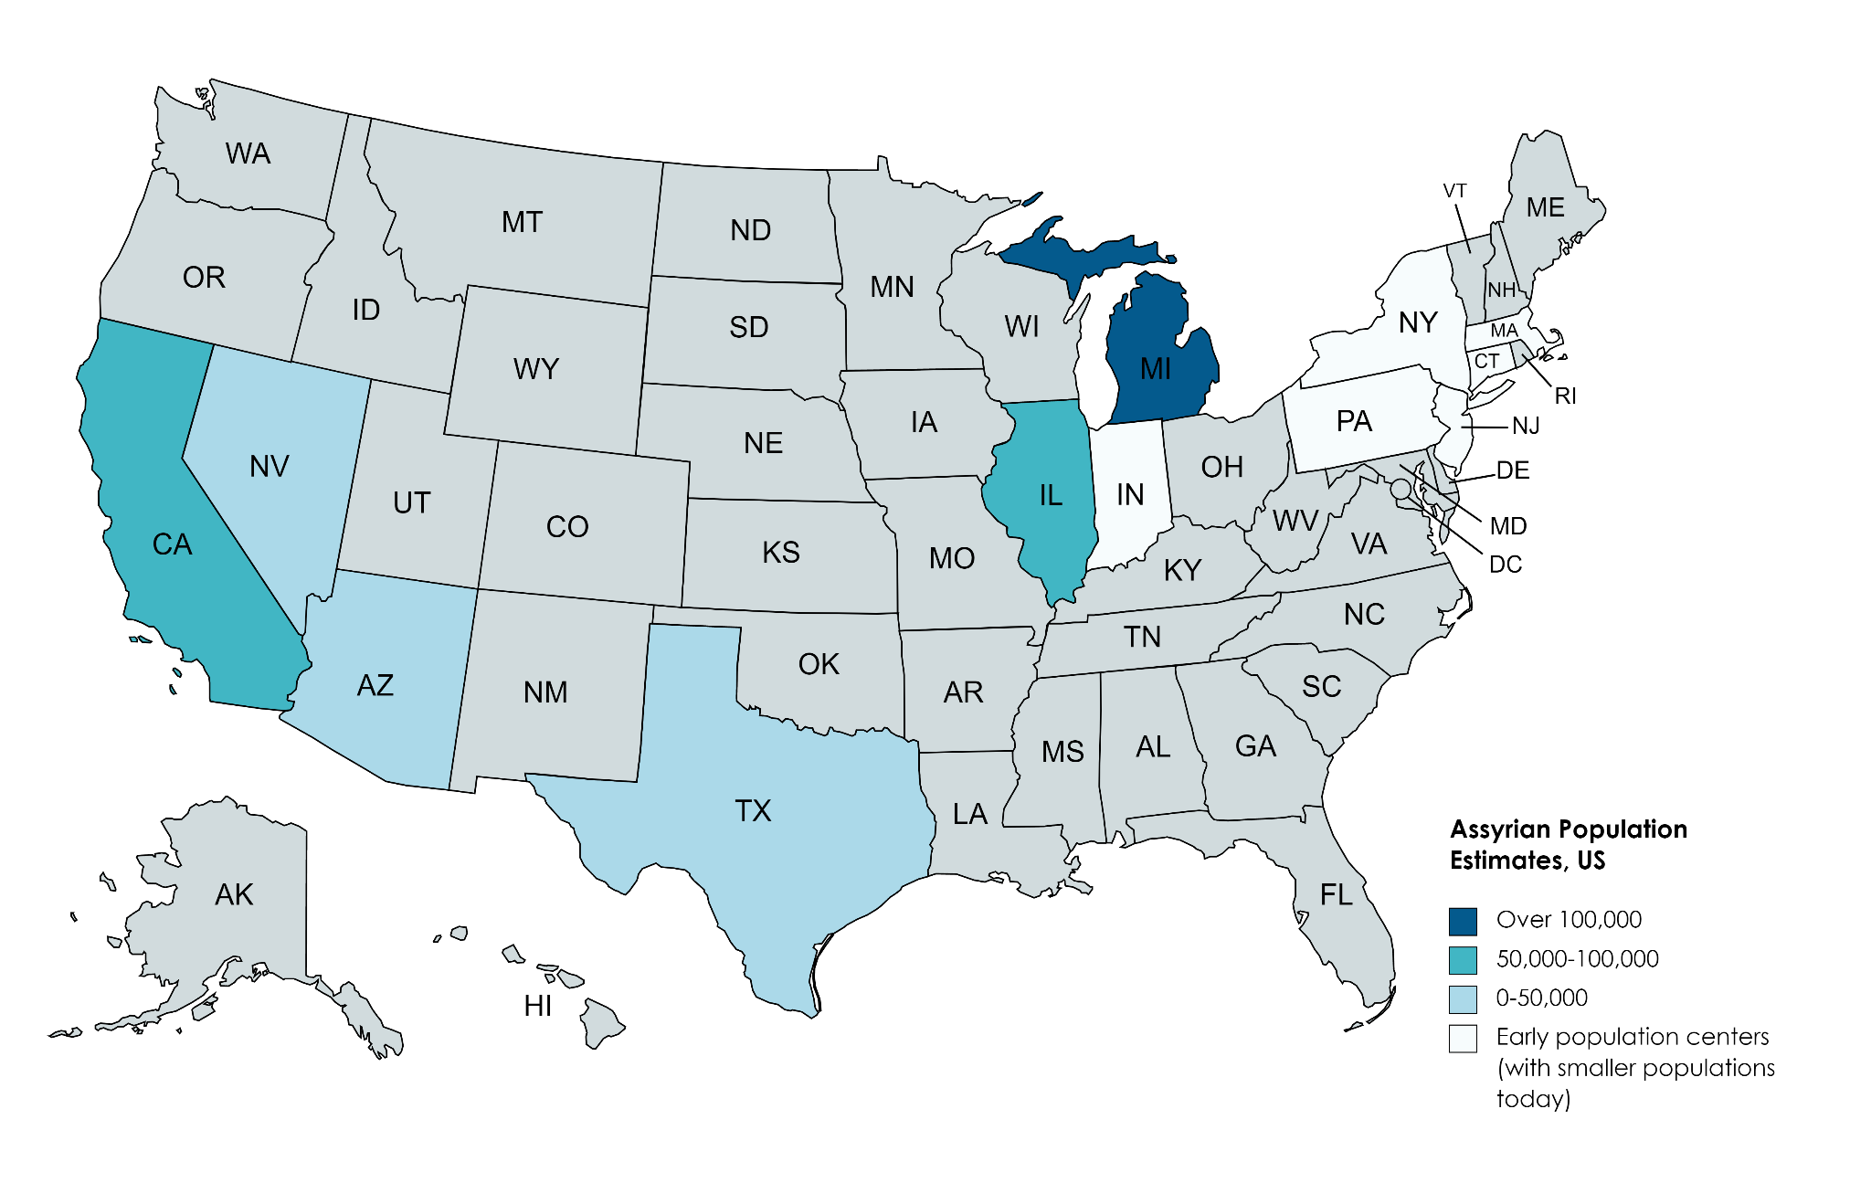
U.S.-based diaspora (estimates)
Notes:
This map shows US states with the largest Assyrian populations today, as well as states that were homes to the first waves of Assyrian settlement (largely New England states). There were small populations in Chicago, California, and New England prior to the genocide, but many of those were workers and students who planned to return home. After the genocide, refugees came to stay permanently in the US because they could not go home again. The population continued to grow over the past century as Assyrians came for economic opportunity, to reunite with family, or to escape oppressive governments, and to escape later waves of violence following the civil wars in Iraq and Syria and ISIS.

